Slide 1
Genome-wide de novo prediction of cis-regulatory binding sites in prokaryotes

Slide 2
Background
There are only a small part of the cis-regulatory binding sites (CRBS) are characterized in E. coli

Slide 3
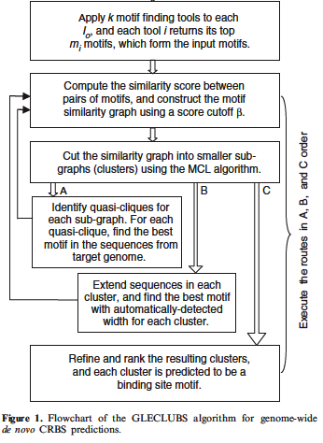
Flowchart

Slide 4
Motif finding programs
MEME
BioProspector

Slide 5
Flowchart

Slide 6
Profile matrix P_{M}
P_{M} = (Prf_{M}(b,i))_{4xL} = (log(p_{M}(b,i)/q(b)))_{4xL}
p_{M}(b,i) = probability of base b appearing at pos I
q(b) = background probability of base b

Slide 7



Self-information
self-information I(ω_{n}) associated with outcome ω_{n} with probability P(ω_{n})
Less likely outcomes will have higher information
Information in a Partitioning C with P(k) being the probability of picking an element in k
Very similar to Entropy = E(I(X))

Slide 8

Information stored in a column of P_{M}
Probability of base b at pos i
Log(p_{M}(b,i)/q(i))
More likely = higher value
Higher I(I,P_{M}) means that we are more confident of the base b at position i

Slide 9
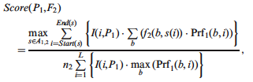
Similarity
Information
frequency
Probability of base b
Select optimal alignment
Upper bound used for normalization

Slide 10
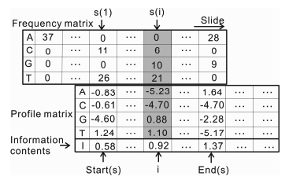
Sliding matrix to find optimal alignment

Slide 11
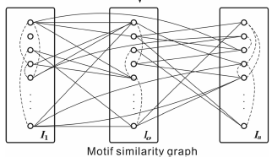
Graph G
I_{o} is set of motifs found given the same starting sequence
Each node is a motif
Each edge connects similar nodes
Edge Weight is motif similarity

Slide 12
Flowchart: Constructing a Similarity graph

Slide 13
Markov clustering algorithm
Van Dongen, S. (2000) Graph Clustering by Flow Simulation PhD Thesis, University of Utrecht, The Netherlands.
Works by using expansion and inflation
Expansion – flow between clusters
Inflation – Strengthens or weakens current cluster
Usually reaches and idempotent matrix
Runs in O(n³) time

Slide 14
MCL pseudo code
G is a graph
add loops to G # see below
set Γ to some value # affects granularity
set M_1 to be the matrix of random walks on G
while (change) {
M_2 = M_1 * M_1 # expansion
M_1 = Γ(M_2) # inflation
change = difference(M_1, M_2)
}
set CLUSTERING as the components of M_1 # see below

Slide 15
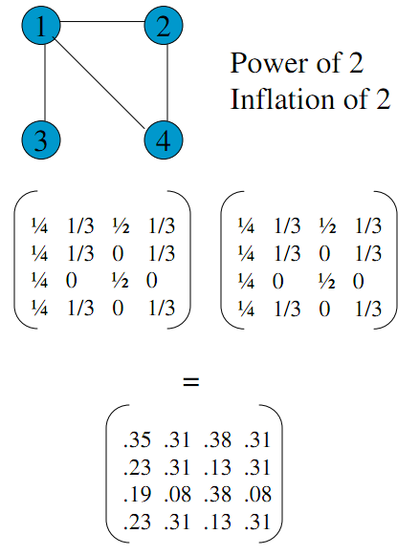
Expansion

Slide 16
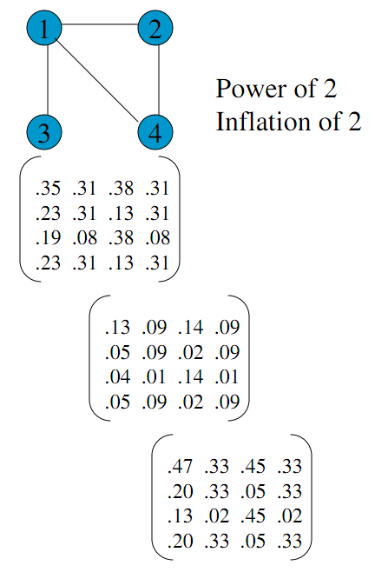
Inflation

Slide 17
Flowchart: Identifying cliques

Slide 18
Finding cliques
Check each node to see if it belongs to a clique
Apply a greedy approach
Deleting a node on the subgraph with the least # of edges
If there is a tie then delete the least weight of edges

Slide 19
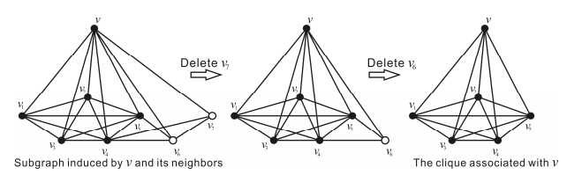
Example of the greedy method to finding a clique

Slide 20

Merge cliques
Merge cliques when ratio of shared nodes is greater than a threshold of:
r_{ab} > .9
R_{ab} > .7

Slide 21
Flowchart: Cluster Ranking

Slide 22

Ranking clusters
Number of seq in best motif
Length of motif
Information in profile P
Number of seq in cluster
Sequences that are common in the cluster and have high information will be highly ranked
Average Information for motif with profile P

Slide 23
Summary

Slide 24
Conclusions

